Slide 1


Slide 2
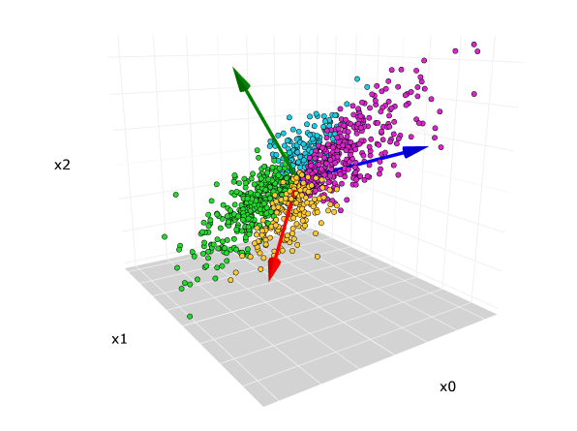
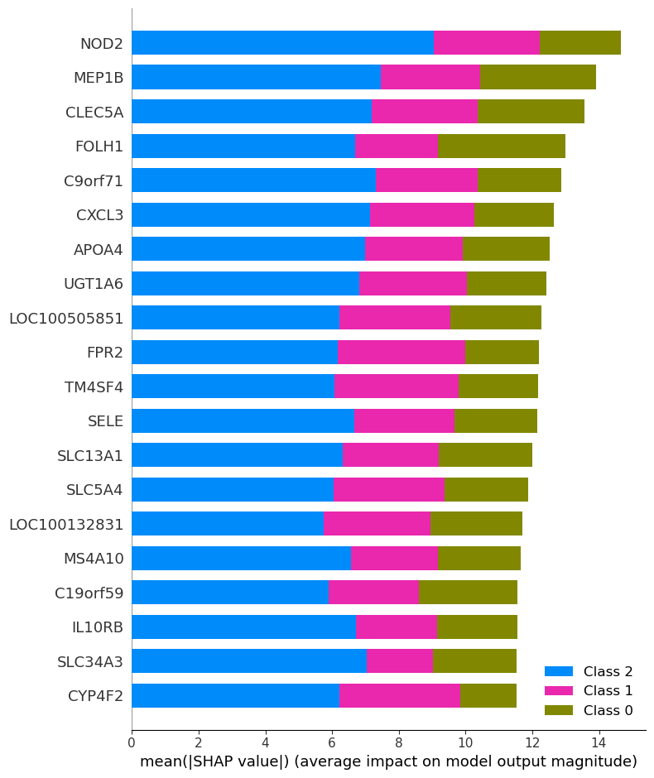
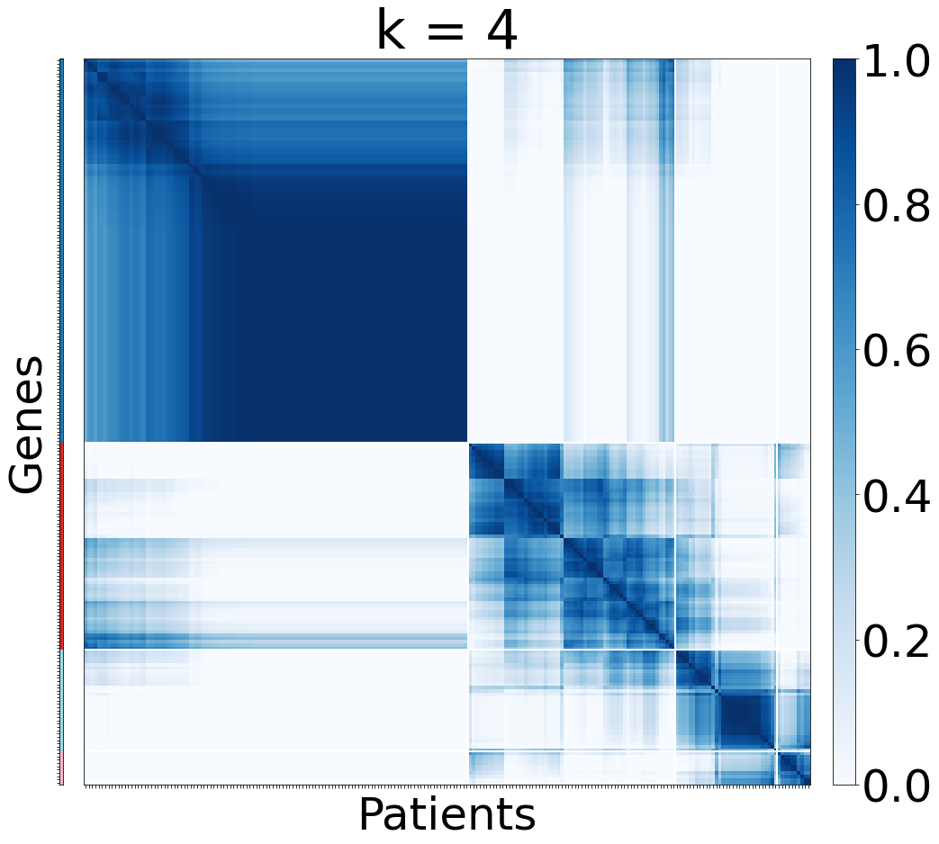
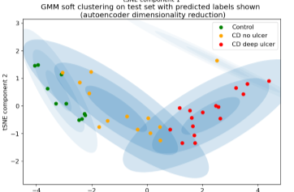
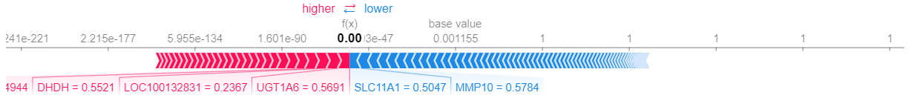
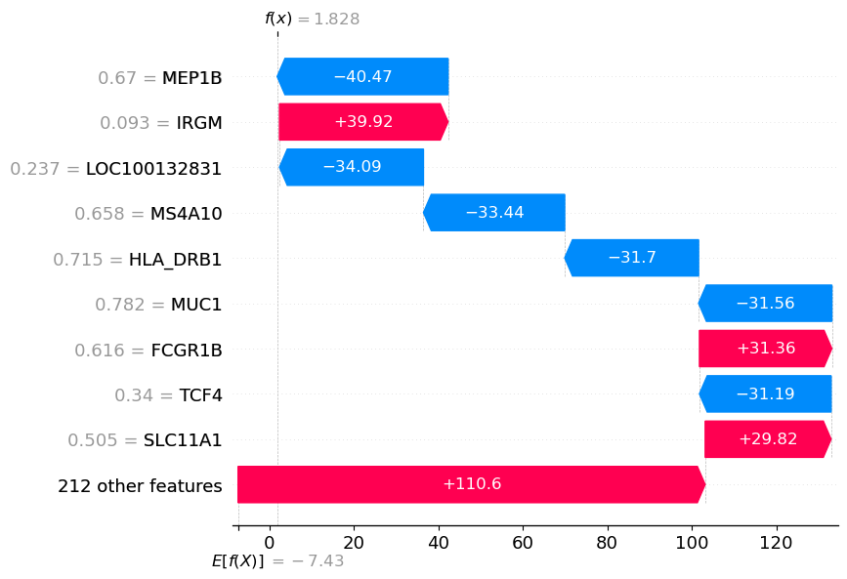
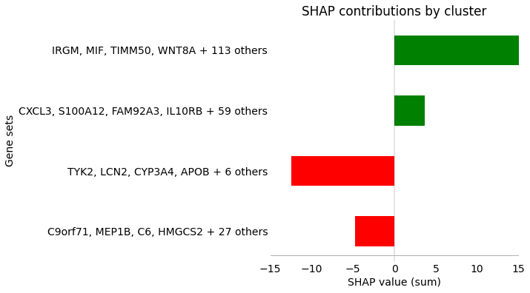
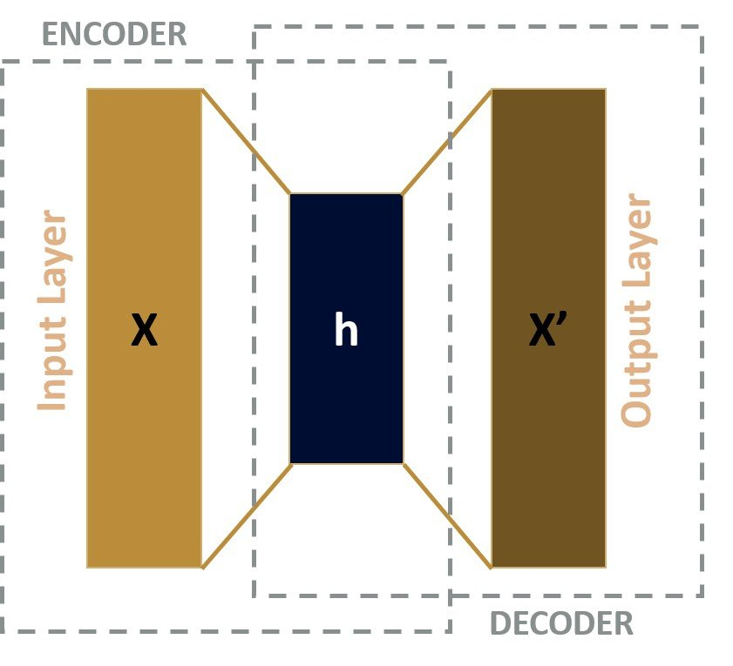
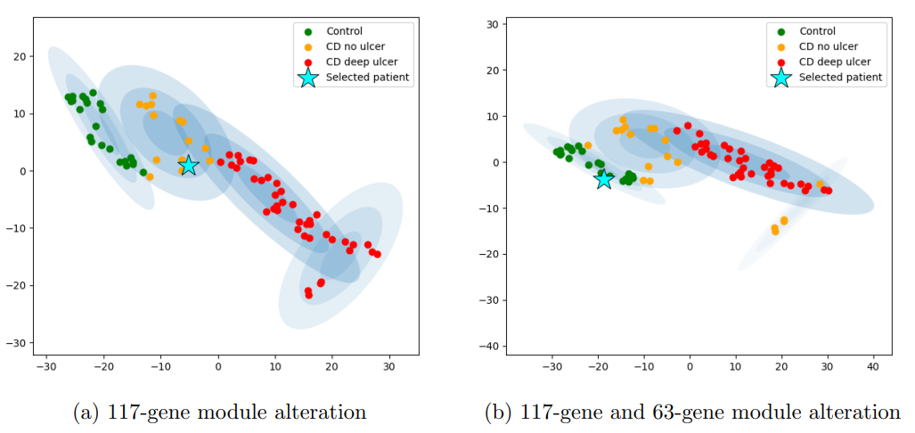
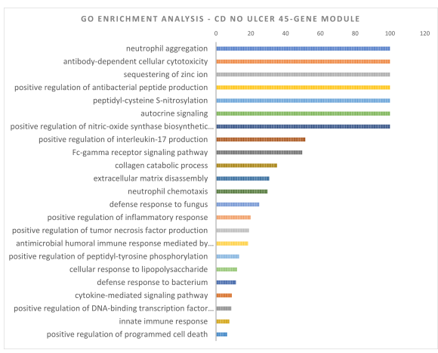
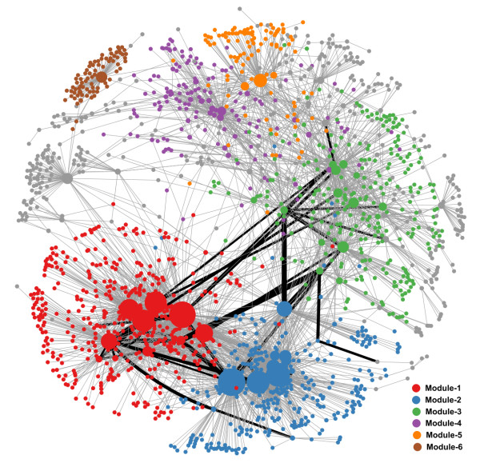
PCA
Consensus clustering - Identifying and characterising gene modules
SHAP – identifying risk genes
RISK dataset
Autoencoder
NOD2
IRGM
Class-contrastive explanations
GO analysis - verification

Slide 3
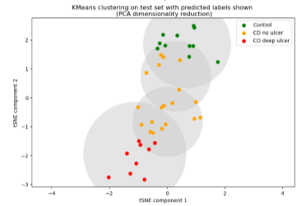
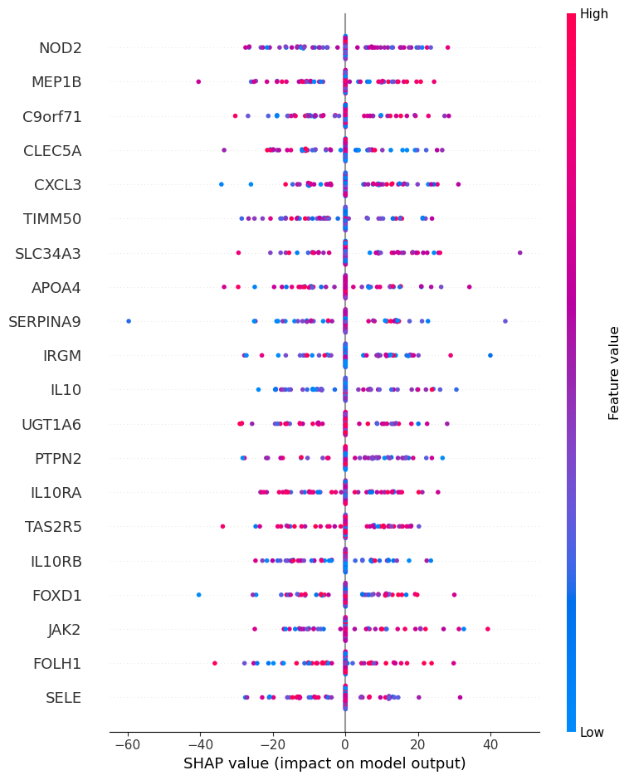
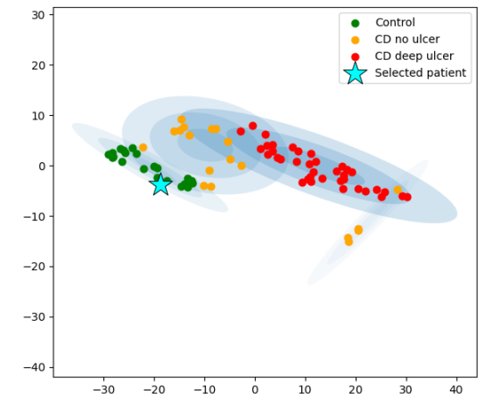
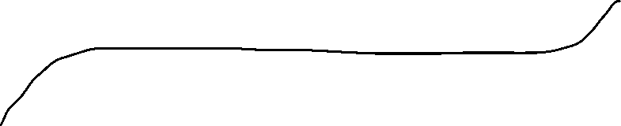


Patient stratification
PCA
+tSNE
RISK dataset
Autoencoder
Derive a
Probabilistic model over phenotypes
+tSNE
Explainability
GO analysis – verifying functional relevance
SHAP adaptation – identifying risk genes
Feedback to clinicians / patients / data scientists
Probabilistic model
Consensus clustering - Identifying and characterising gene modules
NOD2
IRGM
Etc...
Class-contrastive explanations
IL10
Evaluation images shown at full resolution in section xx

